Slide 1
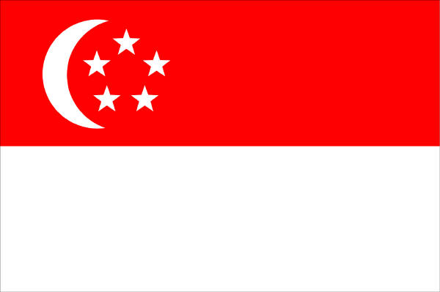
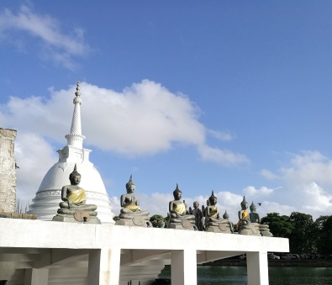
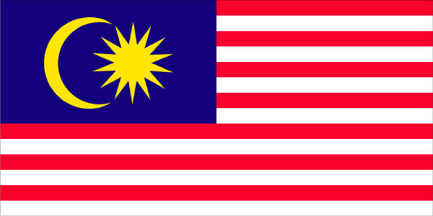
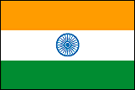
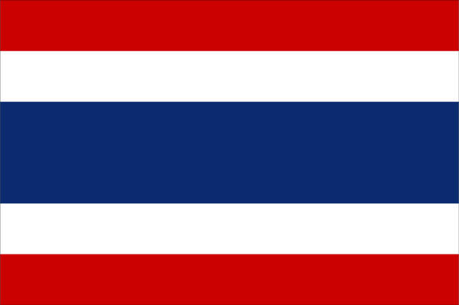
Our Activities 2022
The Japan Council of Local Authorities
for International Relations (J.CLAIR), Singapore

Slide 2
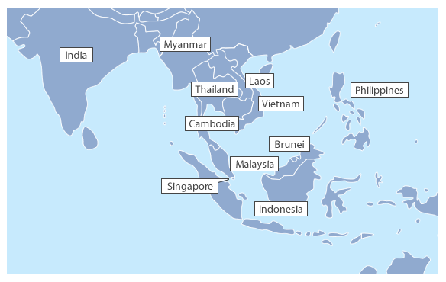
About CLAIR
The Council of Local Authorities for International Relations (CLAIR) was established in July 1988 in response to rising concerns for local level internationalization in Japan. CLAIR was created as a joint organization of local governments to promote and provide support for local internationalization.
CLAIR’s headquarters are located in Tokyo with seven representative offices in Singapore, New York, London, Paris, Seoul, Sydney and Beijing.
J.CLAIR Singapore
J.CLAIR Singapore was set up in October 1990 and conducts activities in the 10 ASEAN countries (Brunei, Cambodia, Indonesia, Laos, Malaysia, Myanmar, Philippines, Singapore, Thailand, Vietnam), India as well as Sri Lanka.
Main Activities
1. International cooperation efforts at local government level
2. Promoting local level exchange
3. Conducting research on local administration and finance systems
as well as the various policies
4. Supporting Japanese local governments’ overseas activities
Sri Lanka
Organizational Structure
Our office consists of 19 staff dispatched from Japan and 6 local staff.
 | No. | Dispatched from
Executive Director | 1 | Ministry of Internal Affairs & Communications
Deputy Executive Director | 1 | Kyoto
Senior Deputy Director | 1 | Hyogo
Deputy Director | 14 | Akita, Tochigi, Oyama City (Tochigi), Tokyo, Ota City (Tokyo), Toyama, Nagano, Aichi, Ichinomiya City (Aichi), Okayama, Yamaguchi, Kitakyushu City (Fukuoka), Miyazaki, Kagoshima
Division Director | 2 | Nagano, Kumamoto
Local Staff | 6 | -
1

Slide 3
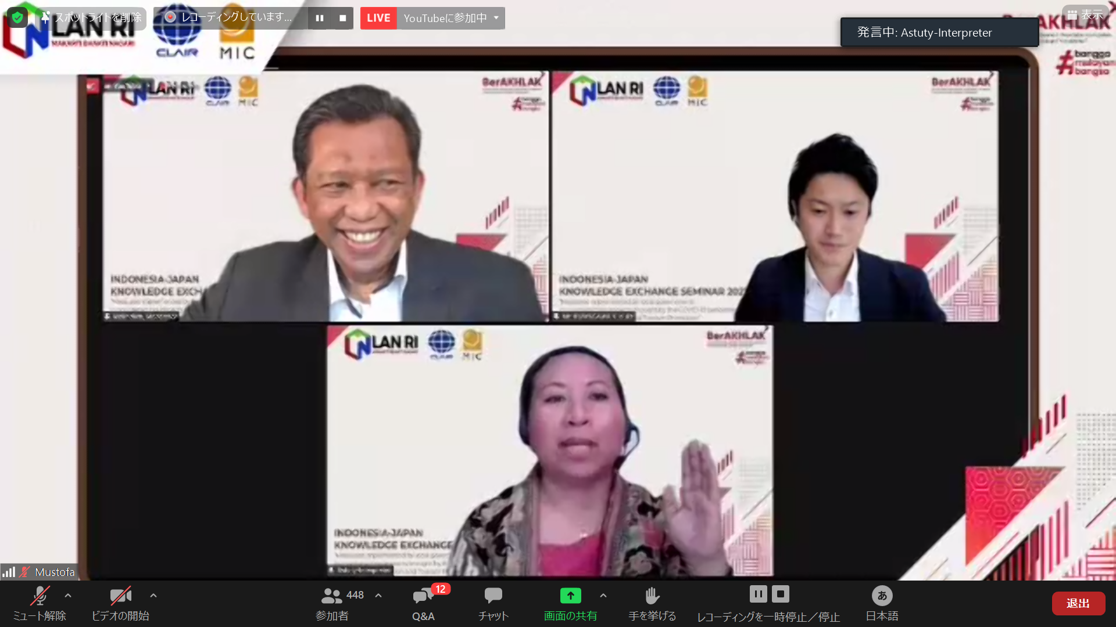
International Cooperation Efforts at Local Government Level
Seminars and Exchange Sessions on Local Administration
【Objective】
With an aim to enhance cooperation and exchange in the area of local administration, J.CLAIR Singapore actively conducts seminars and exchange sessions with local government officials and related organizations in ASEAN countries, India as well as Sri Lanka. These initiatives provide a platform for academics and practitioners of local governance from both sides to discuss best practices and exchange new insights on local administration.
Local Administration Seminars Organized by J.CLAIR Singapore
J.CLAIR Singapore plans and implements local administration seminars with cooperation from our counterparts in order to promote knowledge exchange on issues of particular concern, as well as support the development of local administrative systems in Japan and the respective host countries.
【Seminars in FY2021】
Name of Seminar | Country (City) | Date
Indonesia-Japan Knowledge Exchange Seminar 2021 | Indonesia * | 27 October 2021
*held online
Name of Seminar | Country (City) | Date
CLAIR-DLA-MIC Joint Online Seminar on Local Administration | Thailand * | 17-19 November 2021
*held online
【2021 Joint Online Seminar with Indonesia】
Local Administration Seminar Series Organized by the Ministry of Internal Affairs and Communications
J.CLAIR Singapore actively assists in the local administration seminar series held annually by Japan’s Ministry of Internal Affairs and Communications in cooperation with a host country in the ASEAN region, India or Sri Lanka. J.CLAIR Singapore coordinates the details of the seminar with the co-organizer in the host country and ensures the smooth operation of the actual event.
【Seminars in FY2018/19】
FY | Country (City) | Date | Themes
2019 | Vietnam (Ho Chi Minh) | 29-30 August | Best practices of staff recruitment, utilization of human resources, and training
2018 | Vietnam (Hue) | 10-11 September | Urban Local Governance
* In FY2020, the seminar was cancelled due to COVID-19.
**In FY2021, the seminar was not scheduled for implementation.
Seminar on Best Practices of Japan
J.CLAIR Singapore implements the ‘Seminar on Best Practices of Japan’, which functions as a platform for academics as well as practitioners of local governance in the ASEAN region to understand Japan’s local administration system and the leading urban policies implemented by Japanese local governments.
Staff of J.CLAIR Singapore will participate as speakers, presenting case studies of Japanese local governance and interact with the students during group discussions on a wide array of topics.
【Seminars in FY2021】
FY | Country | Venue | Date
2021 | Malaysia | Universiti Utara Malaysia | 28 September 2021 (held online)
 | Brunei Darussalam | Universiti Brunei Darussalam | 9 February 2022 (held online)
2

Slide 4
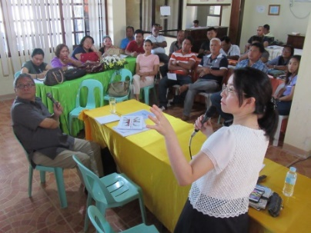
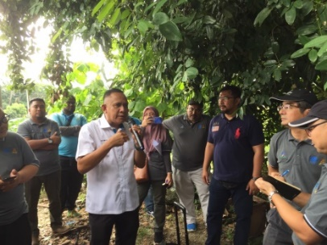
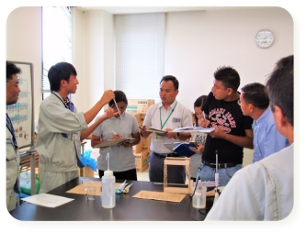
International Cooperation Efforts at Local Government Level
Specialist Dispatch Project
【Projects Held in Previous Years】
FY | Country | Specialists | Area of Expertise
2021 | Thailand | 1 | Agriculture
 | Philippines | 1 | Disaster Management
2019 | Malaysia | 1 | Waste Management
 | Philippines | 1 | Tourism
2018 | Indonesia | 1 | Water Supply & Sewerage
 | Philippines | 1 | Environmental Conservation
 | India | 1 | Waste Management
 | Vietnam | 1 | Fire and Disaster Prevention
2017 | Malaysia | 1 | Urban Planning
 | Indonesia | 1 | Agriculture
 | India | 1 | Water Supply & Sewerage Management
 | Thailand | 1 | Japanese Language Education
 | Philippines | 1 | Disaster Prevention & Preservation of Cultural Assets
【Objective】
To improve the quality of local administration, technical expertise and human resources in foreign local governments.
To increase friendly ties between Japanese and foreign local governments.
【Details】
Since 2000, J.CLAIR Singapore has been dispatching Japanese local government officials (including retirees), with knowledge or technical skills related to international cooperation as specialists to foreign local governments etc. in response to their requests.
【Specialists’ areas of expertise】
Disaster Prevention, Waste Management, Tourism, Fire and Disaster Prevention, Sewerage Management, Health and Sanitation, Environmental Conservation, Education, Public Health, Agriculture and Commerce, Social Welfare, Pottery, Library Management, Water Supply, Local Administration etc.
【A specialist conducting a lecture
to the local participants in
Philippines 】
【A specialist giving guidance
during a local site visit in
Malaysia 】
Local Government Officials Training Programme (LGOTP)
【Objective】
To provide trainees with the know-how and technical skills of Japanese local governments and thereafter, contribute to the development of the trainees’ respective local governments.
【Details】
Jointly organized by CLAIR and Japan’s Ministry of Internal Affairs and Communications, overseas local government officials are hosted as trainees in Japanese local governments, where they will attend lectures and acquire the know-how and skills in various fields such as general administration, environment, agriculture, education, tourism, economic development etc. After an initial introductory training period of about 1 month, trainees are posted to individual host institutions to begin their specialized training and deepen their understanding of Japanese culture and traditions.
【Duration】
The training typically lasts for 6 – 12 months.
【LGOTP Participants in Previous Years】
Country | Number of Participants |  |  |  | Total
 | 1996-2016 | 2017 | 2018 | 2019
Indonesia | 52 | 1 | 1 | 2 | 56
Thailand | 47 | 0 | - | - | 47
Philippines | 42 | 2 | 1 | - | 45
Vietnam | 33 | - | 1 | 1 | 35
Myanmar | 24 | 3 | 4 | 1 | 32
Malaysia | 22 | - | - | - | 22
Laos | 9 | - | - | - | 9
Cambodia | 7 | - | 1 | - | 8
Sri Lanka | 1 | - | - | - | 1
Total | 237 | 6 | 8 | 4 | 255
*The LGOTP from FY2020 to FY2022 were suspended due to COVID-19
【Trainees from Myanmar learning about water quality inspection in Fukuoka city】
3

Slide 5
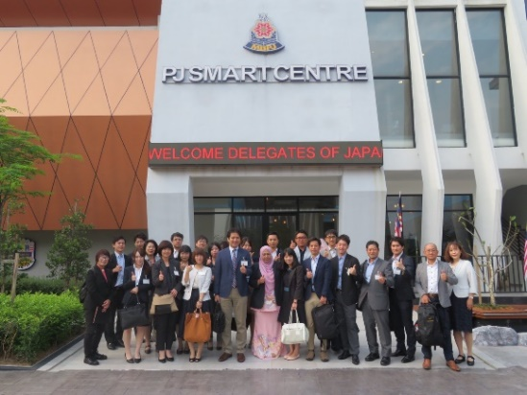
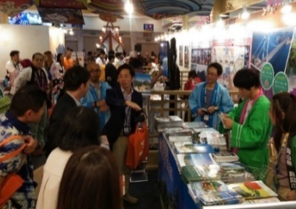
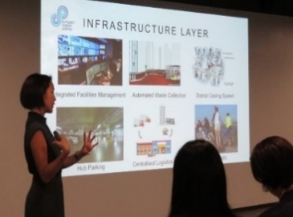
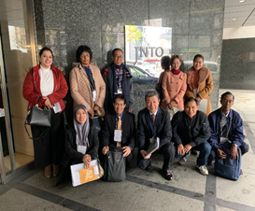
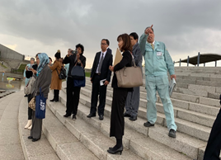
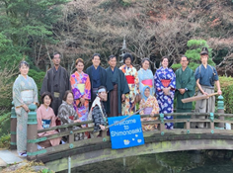
Promoting Local Level Exchange
Regional Exchange Promotion Programme
【Objective】
To enable Japanese local governments to achieve the following:
・Fostering closer understanding of the current situation and challenges pertaining to relations between
Japan and foreign countries.
・Building capacity in leaders who will assume the responsibilities of internationalization of the local area.
・Creating opportunities for the promotion of future regional exchange between Japan and foreign countries.
【Targeted Participants from Japan】
・Local government officials
・Staff of recognized local international exchange associations
・Staff of NPOs referred by local governments
【Exchange Programmes in previous years】
FY | City
2021 | (The programme was cancelled due to COVID-19)
2020 | (The programme was cancelled due to COVID-19)
2019 | Singapore, Kuala Lumpur, Petaling Jaya (Malaysia)
2018 | Delhi, Agra, Tapkala, Mumbai (India)
2017 | Bangkok, Sukhothai, Ayutthaya, Chonburi (Thailand)
2016 | Singapore / Kuala Lumpur, Johor Bahru, (Malaysia)
2015 | Ha Noi, Ho Chi Minh (Vietnam)
2014 | Kuala Lumpur, Johor Bahru (Malaysia)
2013 | Bangkok, Phitsanulok (Thailand)
【Visit to Petaling Jaya City Hall】
【Visit to MATTA FAIR in Kuala Lumpur】
【Briefing on Singapore’s city planning 】
Local Government Exchange & Cooperation Seminar
【Objective】
The purpose of the programme is to increase participants' knowledge of local administration systems in other countries and build network of contacts.
【Seminar Participants in Previous Years】
Country | Number of Participants |  |  |  | Total
 | 1995-2017 | 2018 | 2019 | 2021
Thailand | 36 | 1 | 1 | 1 | 39
Malaysia | 34 | 1 | 1 | - | 36
Philippines | 28 | 1 | 1 | 1 | 31
Vietnam | 24 | 1 | - | - | 25
Indonesia | 23 | 1 | 1 | 1 | 26
Laos | 21 | 1 | 1 | - | 23
Cambodia | 18 | 1 | 1 | 1 | 21
Myanmar | 13 | 1 | 1 | - | 15
India | 8 | 1 | 1 | 1 | 11
Singapore | 6 | - | - | - | 6
Brunei | 5 | - | - | - | 5
Sri Lanka | - | - | - | 2 | 3
Total | 216 | 9 | 9 | 7 | 241
【Content】
Overseas local government officials etc. are invited to Japan to discuss and exchange information on the current situation and various issues of local administration facing local governments in both Japan and their home countries.
In addition, the seminar encourages regional exchange as participants visit local governments during their stay in Japan, go on site visits and have the opportunity to deepen their understanding of Japanese culture.
【Seminar in FY2019】
*In FY2020, the seminar was cancelled due to COVID-19.
*In FY2021, the seminar was held online.
【 Group photo after visiting the Japan National Tourism Organization】
【 Sanyo Waste Treatment Center at Shimonoseki City】
【 Kinomo Experience at Chofu Garden at Shimonoseki City】
4

Slide 6
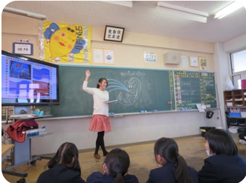
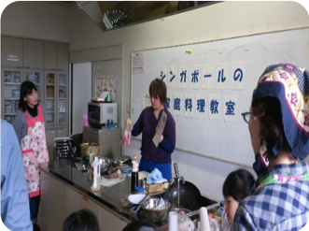
Promoting Local Level Exchange
Support for Sister City Affiliation and Exchange
The first sister city agreement between Japan and this region was signed by Yokohama and Mumbai in 1965. At present, 54 affiliations have been concluded.
CLAIR facilitates sister city affiliation and exchange in response to requests. We provide support for international exchange corresponding to the needs of the region and also provide consultation on sister city affiliation. Please contact J.CLAIR Singapore if you wish to establish an affiliation with a Japanese local government.
The Japan Exchange and Teaching (JET) Programme
【Objective】
To increase cross-cultural understanding as well as contribute to internationalization efforts within Japan.
【Content】
The JET Programme enables local authorities (prefectures, designated cities and other municipalities) to employ foreign youths for the purpose of improving foreign language education as well as promoting international exchange at the local level. By teaching foreign languages at schools nationwide and assisting with international exchange activities organized by local governments, JET participants engage in international exchange at a variety of levels with local residents.
After returning home, many JET alumni continue to contribute towards Japan-related activities through the JET Alumni Association (JETAA).
JETAA has chapters in Singapore, Indonesia, Philippines and India.
ALT: Assistant Language Teachers who provide language lessons in elementary, junior and senior high schools in Japan
CIR: Coordinators for International Relations who work for Japanese local governments to promote international
exchange activities
SEA: Sports Exchange Advisors who promote international exchange through sports
【JET Participants in FY2019 】
Country | ALT | CIR | SEA | Total
Singapore | 63 | 14 | 0 | 77
Indonesia | 0 | 5 | 1 | 6
Philippines | 136 | 2 | 0 | 138
Malaysia | 0 | 2 | 0 | 2
Thailand | 0 | 7 | 0 | 7
Vietnam | 0 | 7 | 0 | 7
Myanmar | 0 | 1 | 0 | 1
India | 0 | 3 | 0 | 3
Total | 199 | 41 | 1 | 241
【An ALT teaching students in a local Japanese school】
【A CIR conducting a cooking session to promote cross-cultural understanding】
Conducting Research
Research and Publications
Research on Local Autonomy Systems and Policies in ASEAN countries, India as well as Sri Lanka
J.CLAIR Singapore currently conducts research on the various policies, local administration and finance systems in ASEAN countries and India, and then compiles them into reports or publications. We have issued several publications in Japanese to disseminate the results of our research to Japanese local governments.
These publications can be found on CLAIR’s website: http://www.clair.or.jp/j/forum/pub/index.html
(only available in Japanese)
5

Slide 7
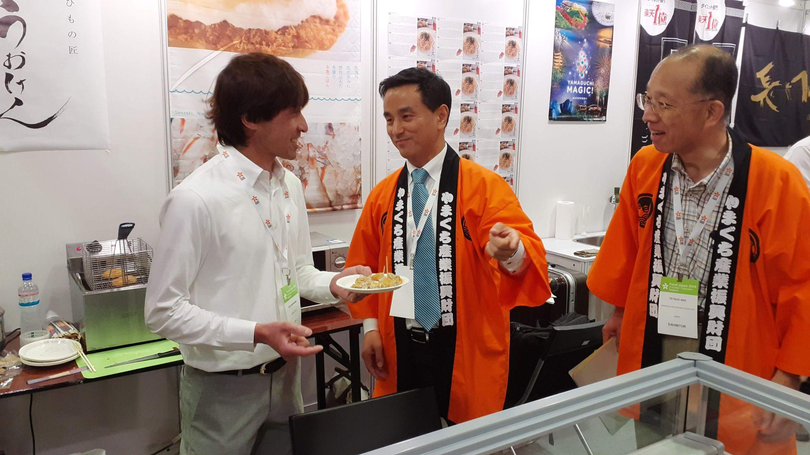
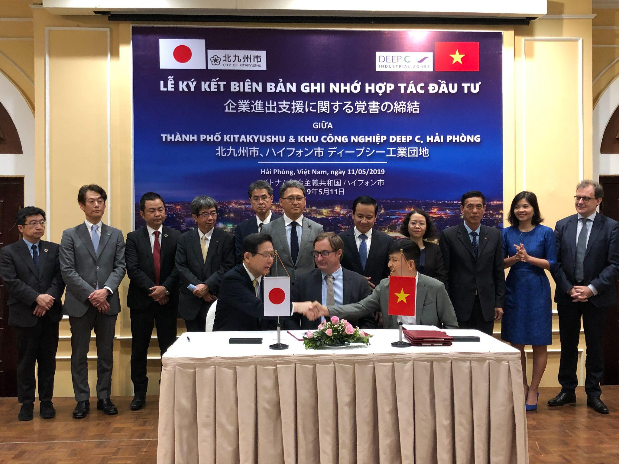
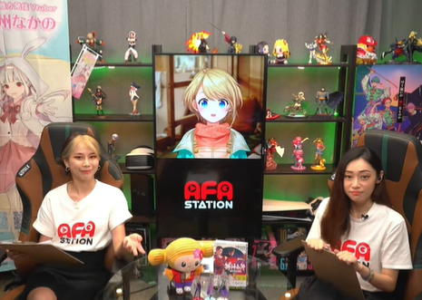
Supporting Japanese Local Government’s Overseas Activities
Support For Overseas Activities of Japanese Local Governments
To support Japanese local government officials and related personnel in their overseas events, research activities and field trips etc. in the 10 ASEAN countries, India as well as Sri Lanka, J.CLAIR Singapore links up the appropriate organizations and individuals, arranges appointments with government agencies, accompanies them on these site visits, conducts briefings on administration systems etc. and provides related reference materials. In FY2021, J.CLAIR Singapore provided support for 28 requests.
As for the support for activities in FY2020 and FY2021, due to COVID-19 restrictions on business trips and events, most of the support were for public relations activities and online events.
【Some activities supported by J.CLAIR Singapore since FY2019】
Japanese Local Government | Content of Support
Higashine City | Operational support for the Mayor hosting promotional event on local specialities from Higashine City (in Singapore)
Tokyo Metropolitan Government | Operational support for Asian Crisis Management Conference (in the Philippines)
Niigata Prefecture | Operational support for promotional event on local specialities from Niigata Prefecture and Tsubamesanjo Region (in Singapore)
Aichi Prefecture | Accompanied the Governor for his meetings with government officials (in Singapore, Indonesia and Vietnam)
Kobe City | Accompanied the Governor, city council members and the business mission from Kobe City for their meetings with government officials and representatives from Japanese companies (in India)
Yamaguchi Prefecture | Operational support for the Governor hosting promotional event (in Singapore)
Kitakyushu City | Accompanied the Mayor’s attendance for the 5th anniversary event of the sister city agreement with Haiphong City (in Vietnam)
Miyazaki City | Operational support for the Mayor hosting promotional event on local specialties from Miyazaki City
Toyohashi City | Promotion of Toyohashi winter vegetables fair at Don Don Donki, Singapore
Saitama Prefecture | PR support for ‘Saitama Japan Premium Shop’, a special Saitama online shop on an e-commerce site (in Singapore)
Oyama City | Cooperation in organising online tours for parents and children (in Singapore)
【Promotion of the region by the Governor of
Yamaguchi Prefecture in Singapore 】
【Ceremony to conclude an agreement between Kitakyushu City and Haiphong City to support business expansion in Vietnam】
Tourism Promotion
【Travel Fairs in FY2019】
Tourism Promotion at International Travel Fairs
Fair | Country(City) | Date
NATAS Holidays | Singapore | August
Japan Travel Fair 2019 | Malaysia (Kuala Lumpur) | November
Japan Travel Fair 2019 | Indonesia (Jakarta) | August
Travel Madness Expo | Philippines (Manila) | July
Travel Tour Expo |  | February
【Objective】
To support Japanese local governments’ attempts to boost local economies through tourism, J.CLAIR Singapore ties up with Japan National Tourism Organization (JNTO) to participate in international travel fairs in Singapore, Malaysia,
Philippines, and Indonesia.
J.CLAIR Singapore compiles
reports on the events and
disseminates the findings to
Japanese local governments.
*In FY 2020 and 2021, J.CLAIR Singapore did not participate in travel fairs due to the border restrictions of COVID-19.
Inbound Promotion Project using Anime
We provide local governments with PR opportunities targeting those interested in Japanese anime and manga in order to tap on new demand for visiting Japan. In FY2021, J.CLAIR Singapore contributed to the creation of four videos introducing local governments using popular anime sites, which were broadcasted on the online platform ‘AFA Station TV’ in two batches in August/September 2021 and February 2022.
【Launching of the programme in Feb 2022 】
6

Slide 8
J.CLAIR Singapore
The Japan Council of Local Authorities for International Relations, Singapore
1 Raffles Place, #30-03 One Raffles Place, Singapore 048616
TEL 65-6224-7927 FAX 65-6224-8376
E-mail info@clair.org.sg
URL http://www.clair.org.sg
Facebook https://www.facebook.com/clairsg/
Newsletters http://www.clair.org.sg/newsletter/

